Slide 1


Memory & Learning

Slide 2
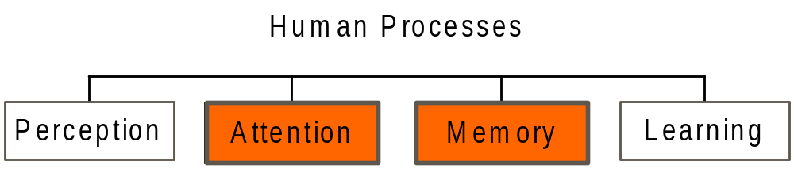
Cognitive Processes - Memory
Attention
Human Considerations

Slide 3
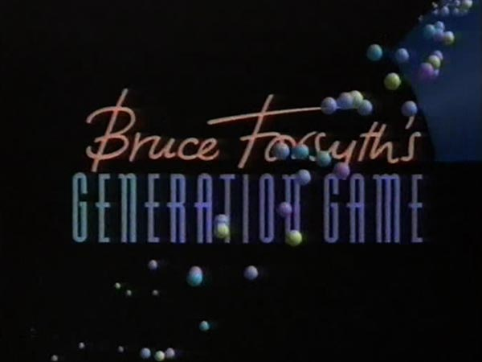
Exercise 1: The Conveyor Belt Game
https://youtu.be/HYnbHz4kZ_4 from 55:40

Slide 4
Cognitive Processes - Memory
Memory
Categories
Of Memory
Recognition
Vs. Recall
Techniques to
Guide Memory
Human Considerations

Slide 5
Cognitive Processes - Memory
Say aloud the numbers, 1, 7, 4, 2, 8.
Next, repeat them -> Short-term memory
Human Considerations

Slide 6
Cognitive Processes - Memory
Say aloud the numbers, 1, 7, 4, 2, 8.
Next, repeat them -> Short-term memory
1, 7, 4, 2, 8
What were the 4 user groups discussed in a few week’s ago?
Human Considerations

Slide 7
Cognitive Processes - Memory
Say aloud the numbers, 1, 7, 4, 2, 8.
Next, repeat them -> Short-term memory
1, 7, 4, 2, 8
What were the 4 user groups discussed in last week’s lecture?
Skills & Knowledge, Disabilities, Age & Cultural -> Long-term memory
Human Considerations

Slide 8
Cognitive Processes - Memory
Memory is involved in all our cognitive tasks and has 3 major components:
  Sensory memory –
    ‘Snapshot' of our environment, stores this information for a short period
    Act as buffers for stimuli received through the senses
    Holds information for a short time e.g., visual information fades away in less than a second
  Short-term memory –
    Information of the present
    Information retained automatically and retrieved without effort
    Amount of information that can be retained is severely limited – Miller’s chunking concept (7 +/- 2)
  Long-term memory –
    Information of the past
    Amount of information that can be retained is unlimited
Human Considerations

Slide 9
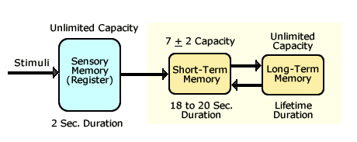
Cognitive Processes - Memory
Capacity and Duration of Memory Components***
***Values for the duration of sensory and short-term memory will vary by study & researcher
Human Considerations

Slide 10

Cognitive Processes - Memory
Short-term Memory
Do you remember which of the shapes below were shown?
Human Considerations

Slide 11







Cognitive Processes - Memory
Short-term Memory
Do you remember which of the shapes below were shown?
Human Considerations

Slide 12
Cognitive Processes - Memory
Short-term Memory
Do you remember which of the shapes below were shown?
Human Considerations

Slide 13
Cognitive Processes - Memory
Recognition vs Recall (Knowledge in the world vs knowledge in the head)
We can recognise material far better than we can recall it
Human Considerations

Slide 14
Cognitive Processes - Learning
How do we learn??
Human Considerations

Slide 15
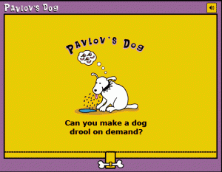
Do we learn like a Behaviourist?
Cognitive Processes - Learning
Notes:
Classical conditioning– association
Operant conditioning – repetition through reinforcement

Slide 16
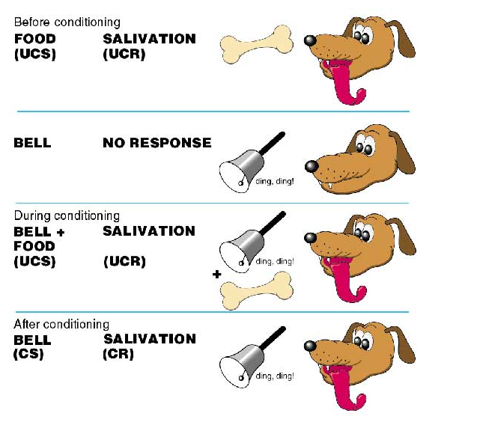
Do we learn like a Behaviourist?
Cognitive Processes - Learning
http://www.simplypsychology.org/pavlov.html
Notes:
Classical conditioning– association
Operant conditioning – repetition through reinforcement

Slide 17
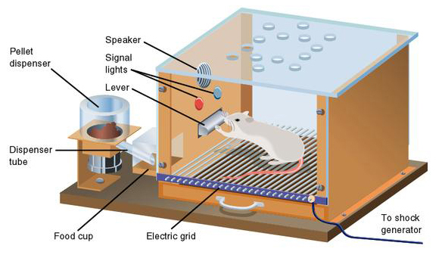
Do we learn like a Behaviourist?
Cognitive Processes - Learning
Notes:
Classical conditioning– association
Operant conditioning – repetition through reinforcement

Slide 18
Cognitive Processes - Learning
Do we learn like a Cognitivist?
What have we learned about cognitive processes?

Slide 19
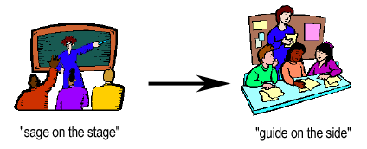
Cognitive Processes - Learning
Do we learn like a Constructivist?
Learners construct knowledge for themselves
Learning is an active process
Learning is a social activity
Human Considerations

Slide 20
Cognitive Processes - Learning
Do we learn like a Humanist?
You decide how you learn!!!

Slide 21
Exercise
How are these theories applicable to
interface design?

Slide 22
Terms of Reference
    Norman, D. (1990) The Design of Everyday Things
    Preece, J. et al. (2002) Interaction Design
    Shneiderman, B. & Plaisant, C. (2005) Designing the User Interface
    Benyon, D. et al (2005) Designing Interactive Systems
    Miller, G. (1956) The Magical Number Seven, Plus or Minus Two: Some Limits on Our Capacity for Processing Information
    Tullis, T. (1984) A Computer-Based Tool for Evaluating Alphanumeric Displays
    FAA (..) FAA Human Factors
    http://www.ted.com/index.php/talks/view/id/7 (video)
References

